Slide 1
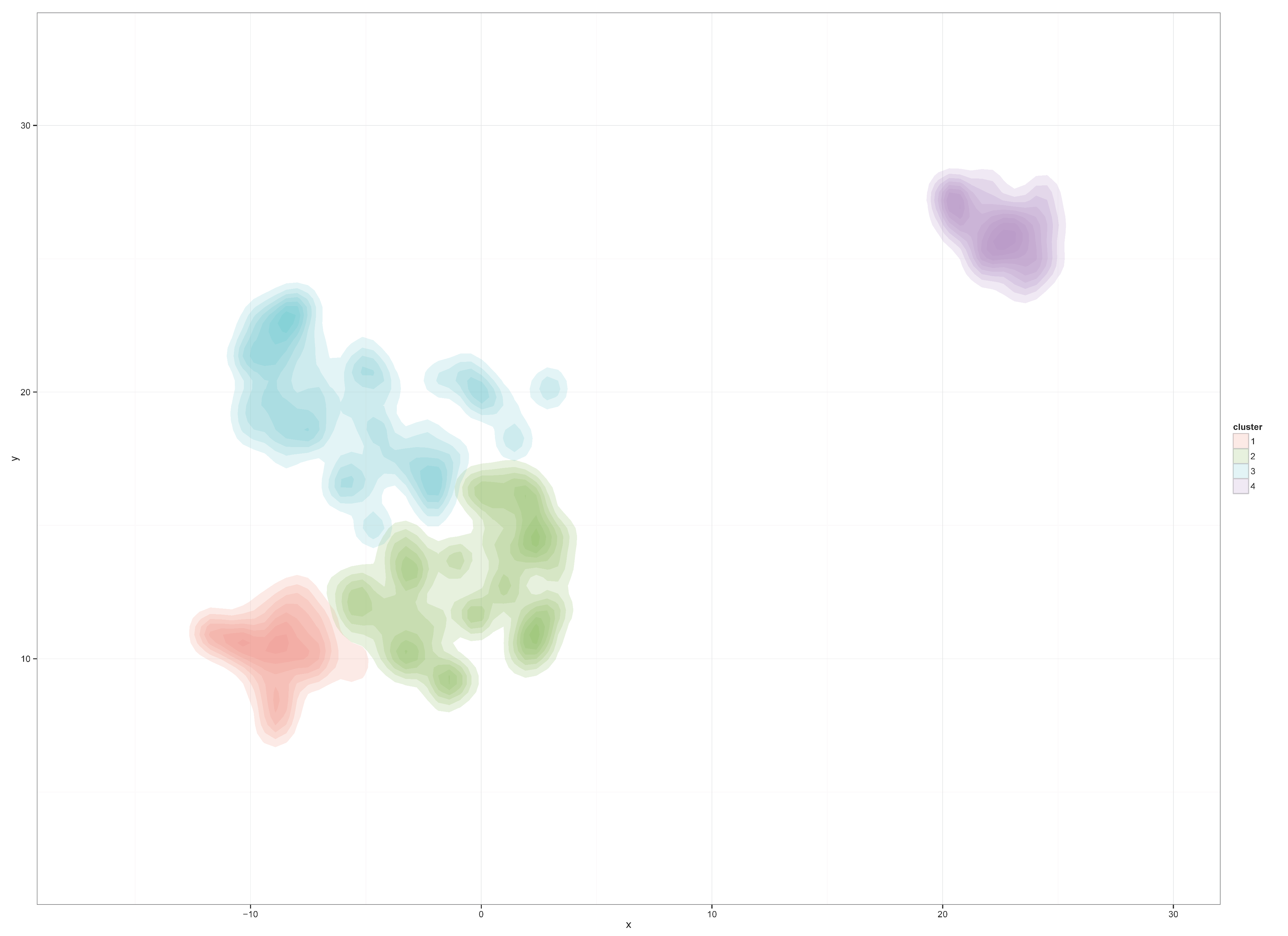

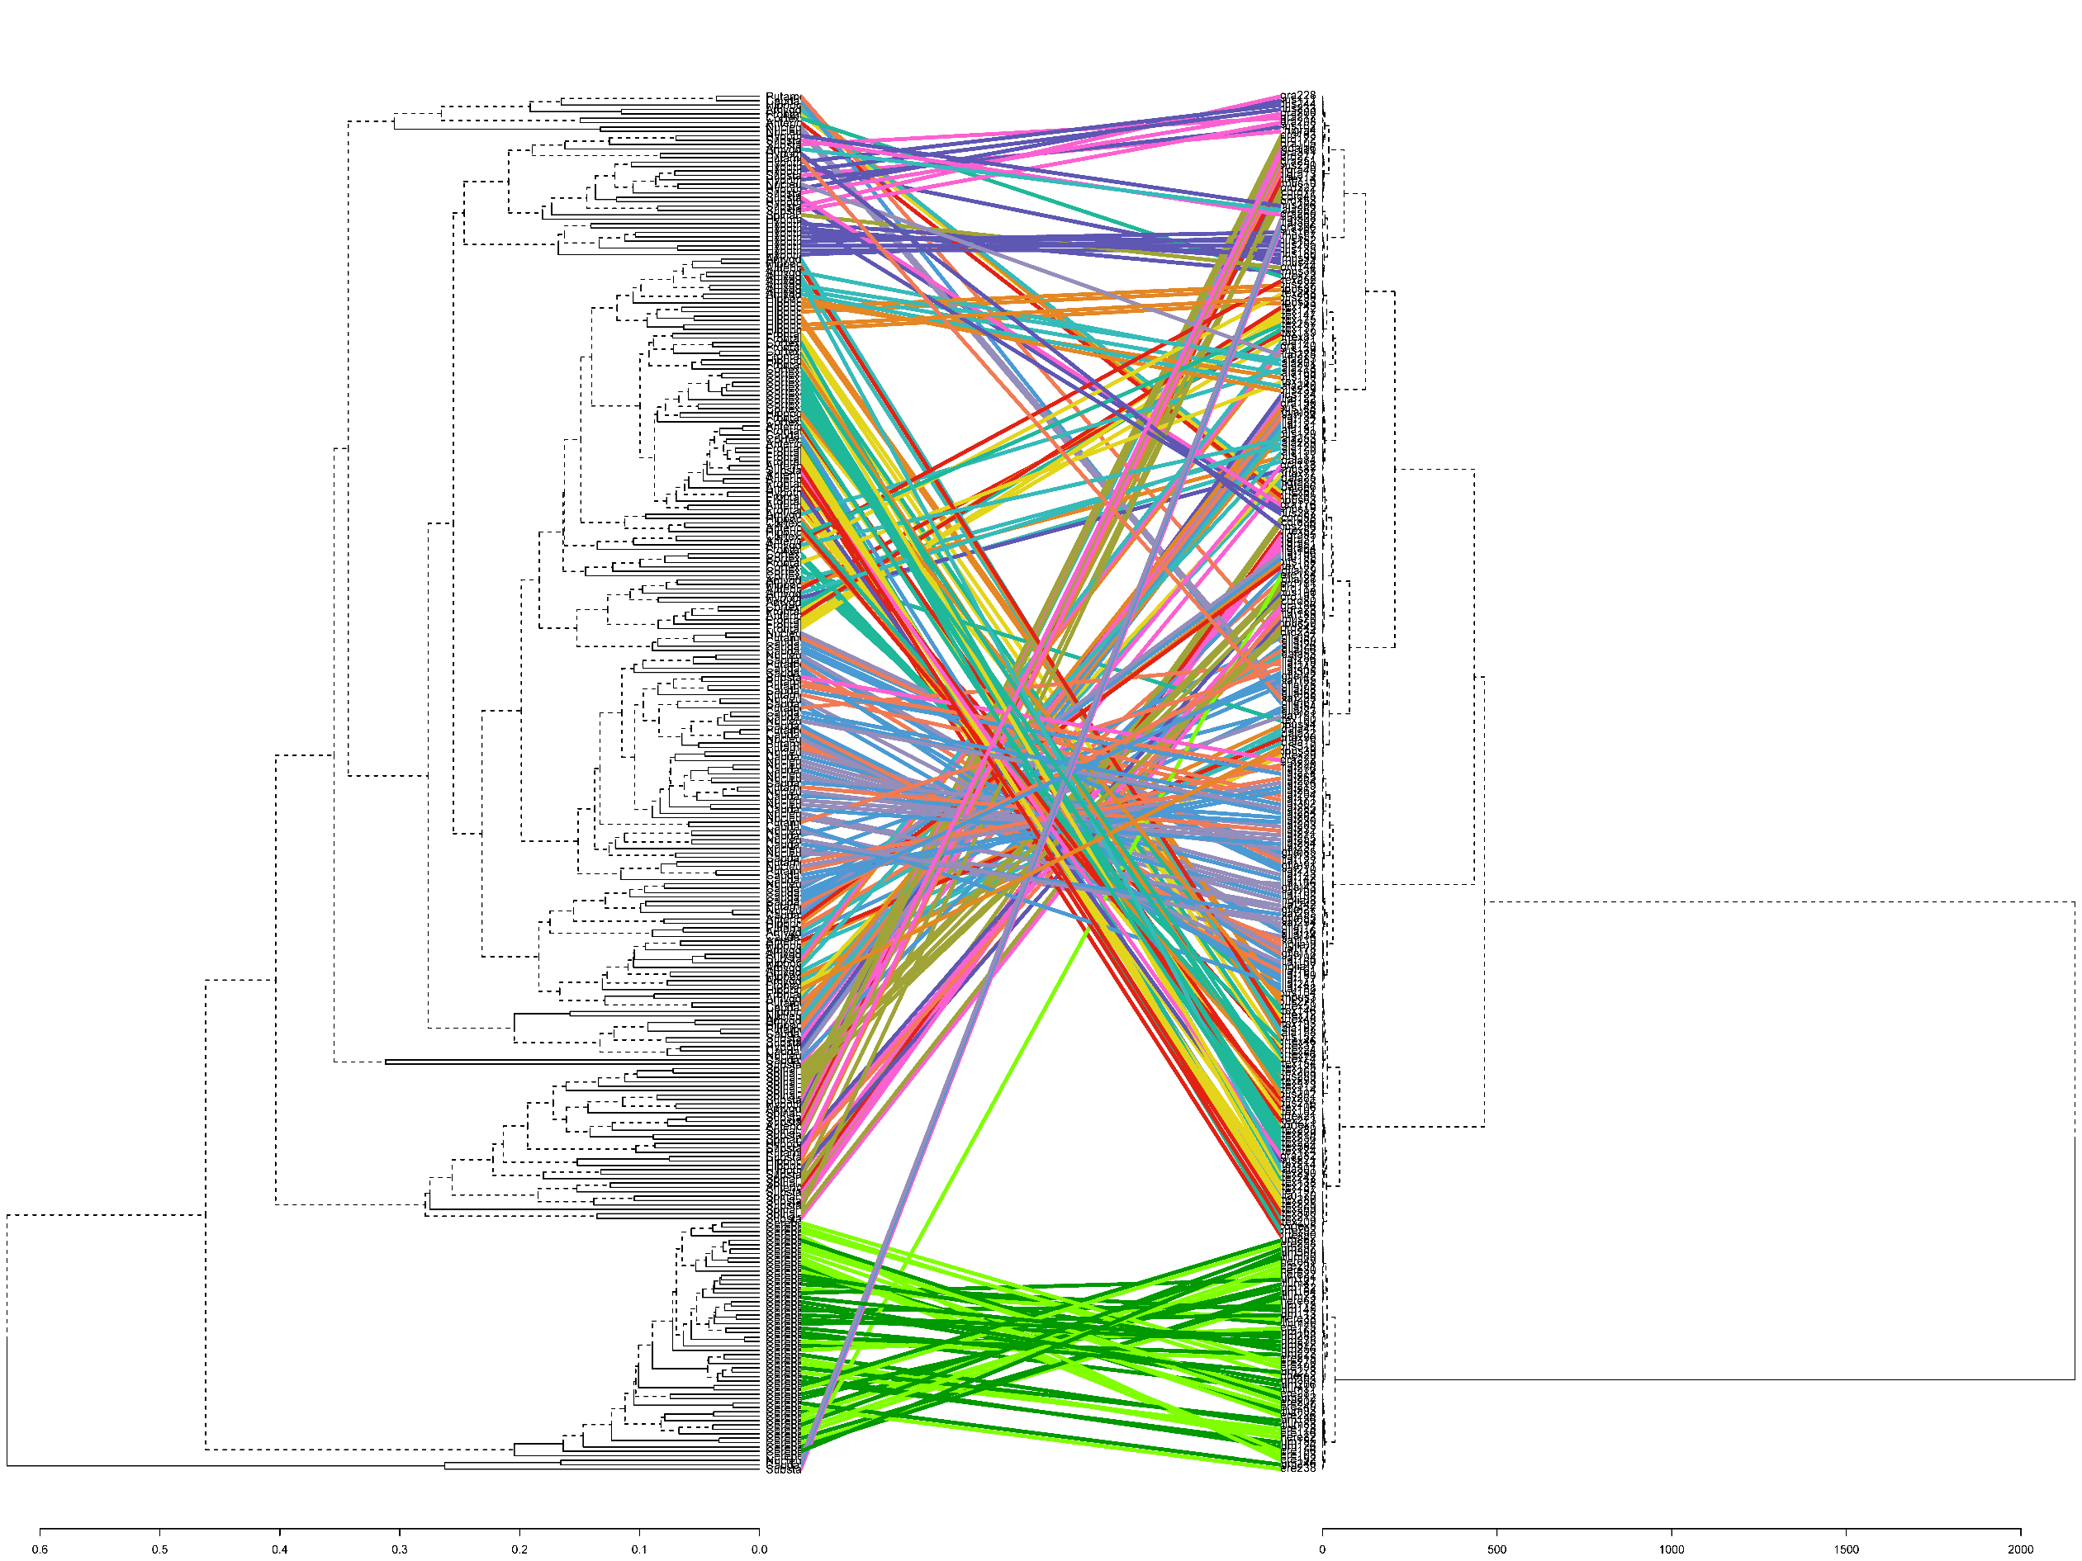
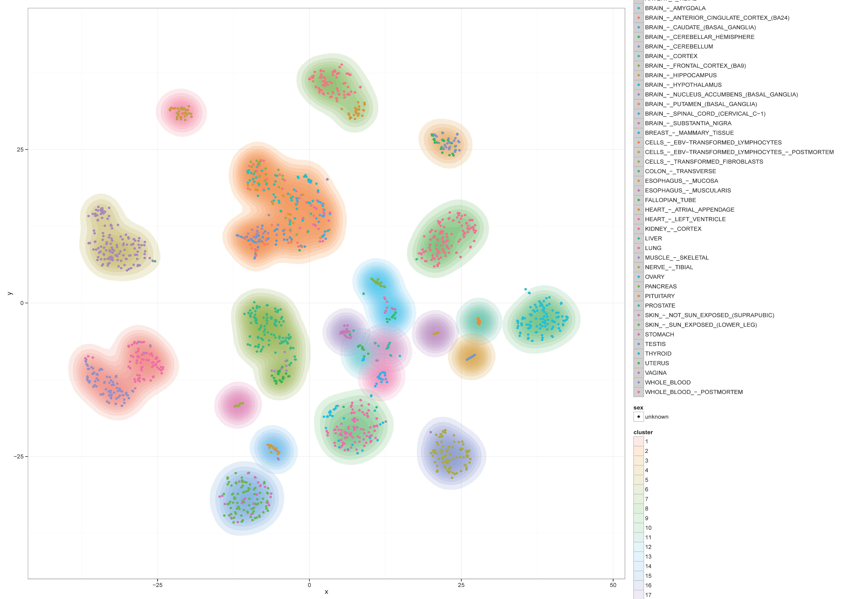
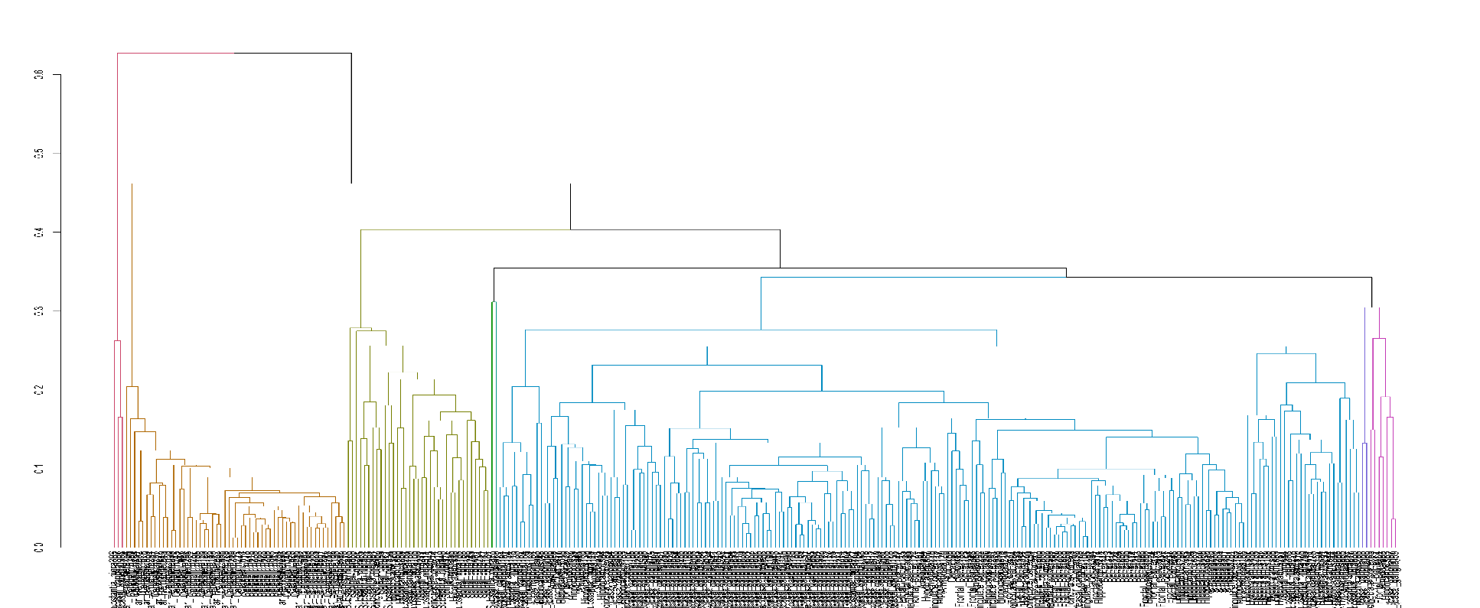
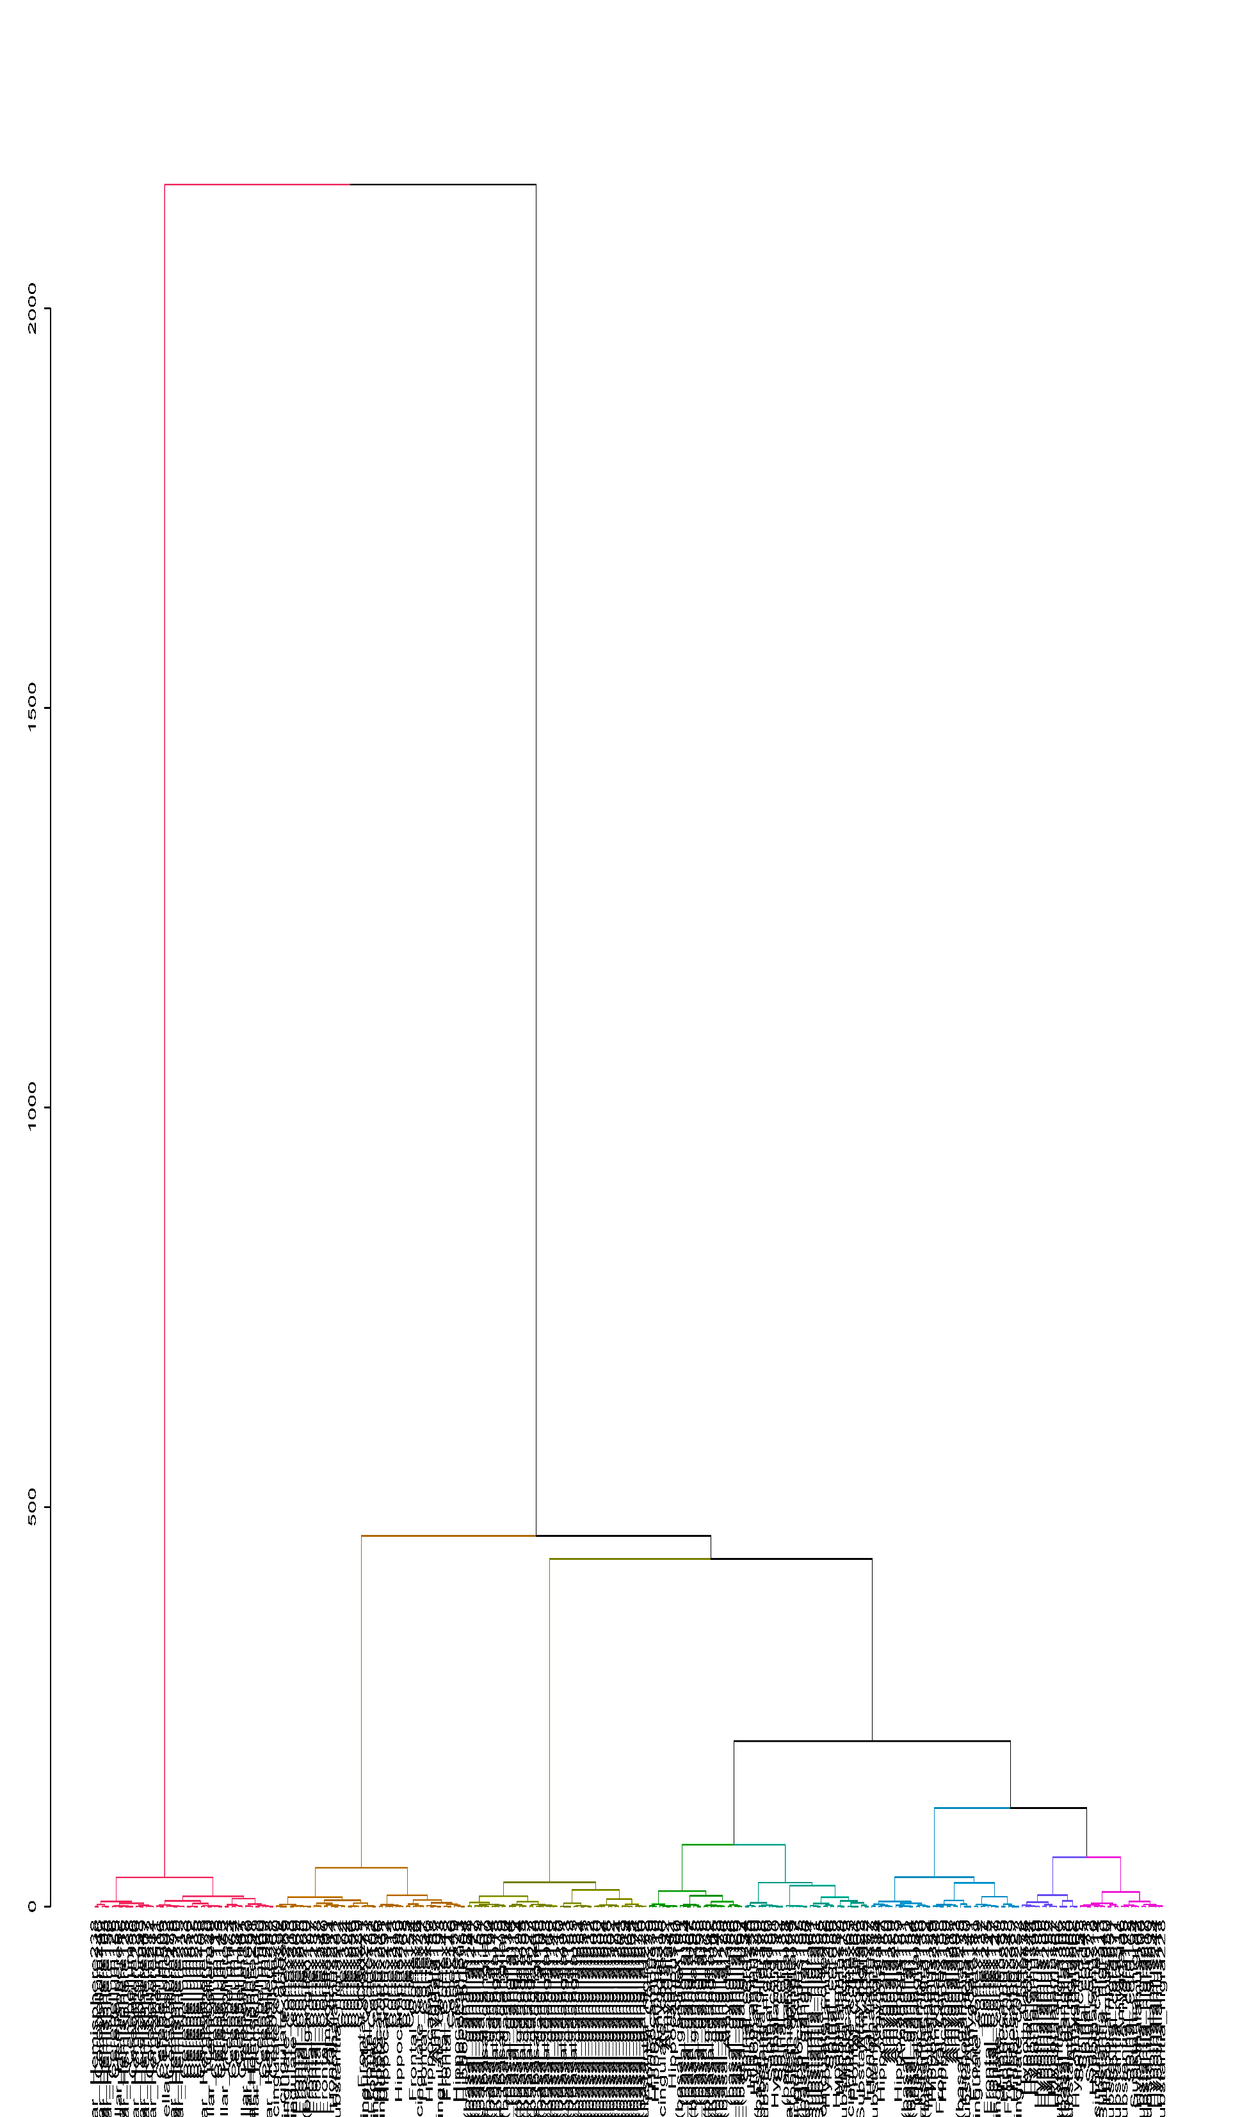
a
b
Frontal Cortex
Cluster 7
Anterior Cingulate Cortex
Heart
Cortex
Left Ventricle
Cluster 22
Atrial Appendage
Hypothalamus
Cells
Ebv-Transformed Lymphocytes
Cerebellar Hemisphere
Cerebellum
Cluster 3
Hippocampus
Cluster 2
Brain
Amygdala
Substantia Nigra
Cluster 8
Spinal Cord
Cluster 5
Lung
Skeletal
Muscle
Nucleus Accumbens (Basal ganglia)
Caudate (Basal ganglia)
Brain
Putamen (Basal ganglia)
Cluster 13
Cluster 10
c
Spinal cord
Substantia Nigra
Brain
Liver
Pancreas
Thyroid
Cluster 6
Kidney
Cluster 11
Hypothalamus
Cluster 1
Artery
Cluster 17
Stomach
Pituitary
Whole blood
Tibial
Esophagus
Muscularis
Colon
Post-mortem
Coronary
Cluster 19
Caudate (basal ganglia)
Frontal cortex
Cortex
Amygdala
Hippocampus
Pre-mortem
Aorta
Prostate
Cluster 12
Cluster 18
Fallopian Tube
Adrenal
Gland
Uterus
Spinal Cord
Cluster 20
Ovary
Cluster 4
Cells
Transformed
Fibroblasts
Cluster 21
Testis
HC
Original Space
Breast
HC
Low Dimensional Space
Cluster 16
Nucleus Accumbens
(Basal ganglia)
Caudate (Basal ganglia)
Putamen (Basal ganglia)
Cluster 14
Nerve
Vagina
Esophagus Mucosa
Cluster 9
Frontal Cortex
Anterior Cingulate Cortex
Cortex
Adipose
Spinal cord
Substantia Nigra
Cluster 15
Subcutaneous
Skin
Visceral
Not sun exposed
Cerebellar Hemisphere
Cerebellum
Cluster density map
Sun exposed
Cerebellar Hemisphere
Cerebellum
Samples
Samples outside tissue-of-origin cluster

